Slide 1
Barcode Reader Database
Carlos Salas | Ada Pluguez

Slide 2
System Description
Our project will keep track of a store’s inventory
Admin will be able to update,delete and/or add product to the inventory
Git: https://github.com/adaPlu/Barcode-Reader-CSE111

Slide 3
Most Important User-cases
Inventory Clerk Use Cases:
Scans the products
lookUpItem
Entry Condition: Open Application/Click Scan Button
Scan Item
Display Price
Remove/add inventory
Admin Use Cases:
Updates, adds, and/or removes product from database
Displays inventory

Slide 4
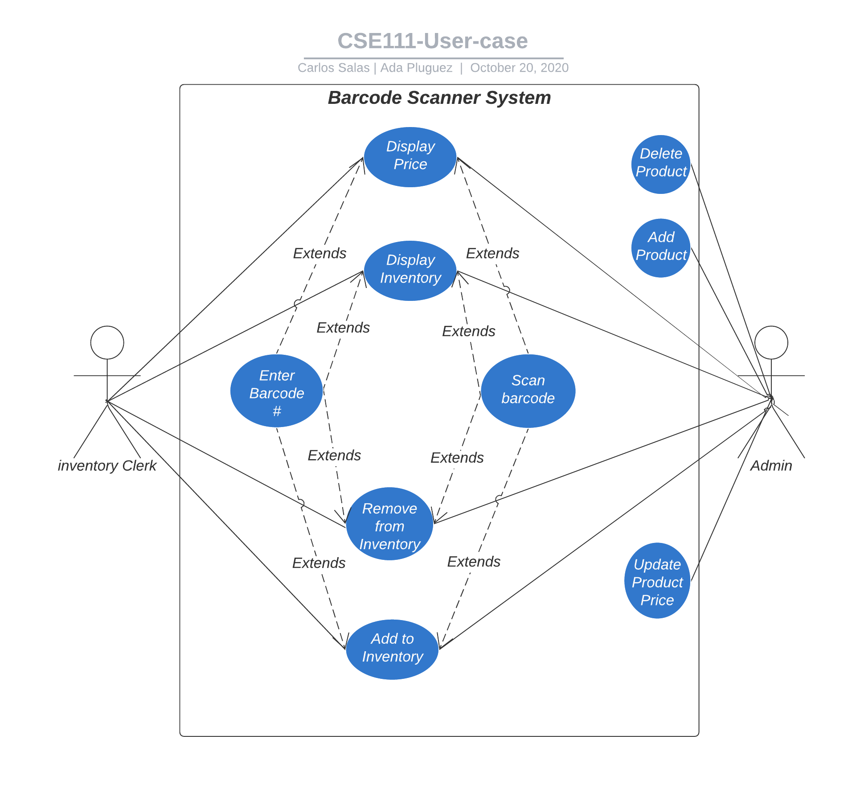
Use-case Diagram

Slide 5
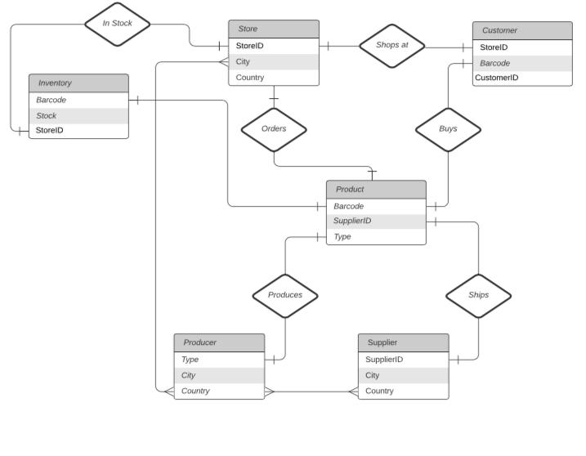
E/R Diagram

Slide 6
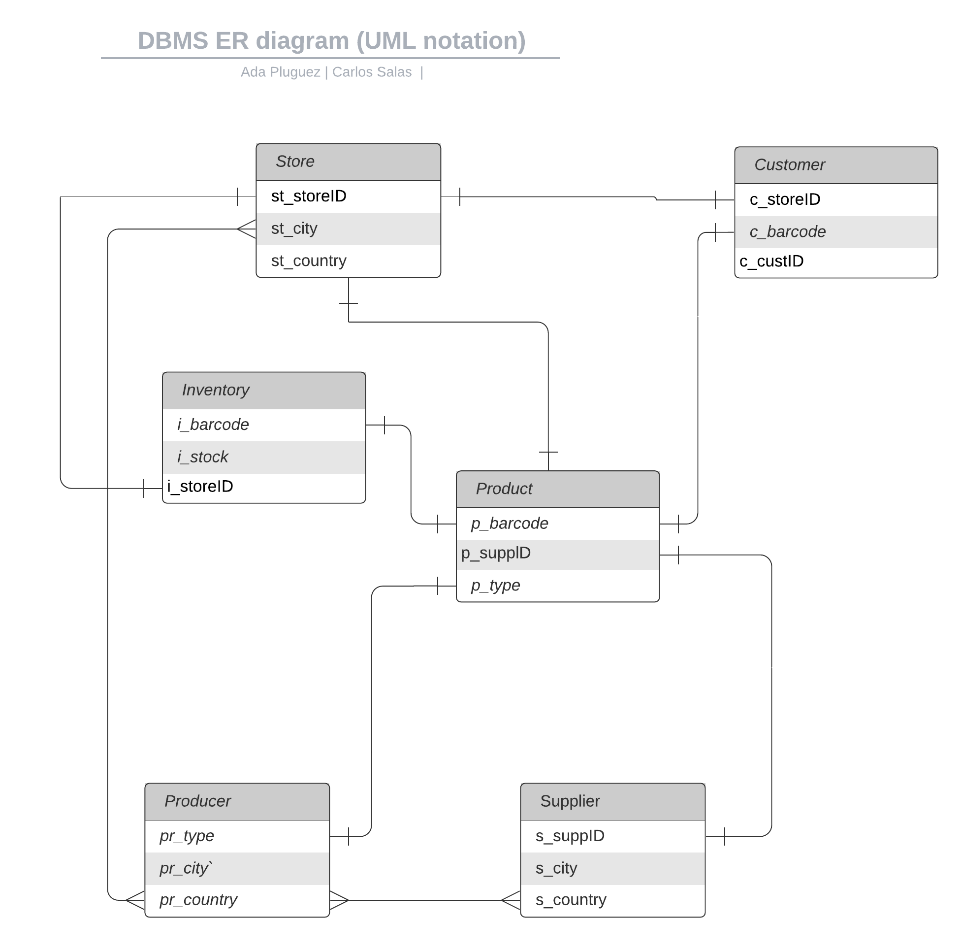
Relational Schema
Inventory
- i_barcode
- i_stock
- i_storeID
Producer
- pr_type
- pr_city
- pr_county
Supplier
- s_supplierID
- s_city
- s_county
Product
- p_barcode
- p_suppliedID
- p_type
Customer
- c_storeID
- c_barcode
- c_customerID
Store
- st_storeID
- st_city
- st_county

Slide 7
Thank You

